Slide 1

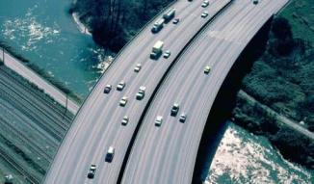

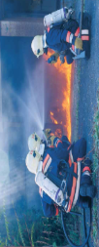
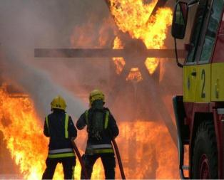

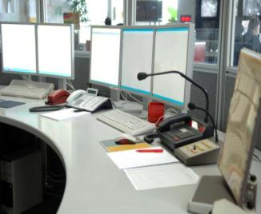
Integrated Information System for
Mission Planning
and Forest Fires Crisis Management
Antonis Kostaridis Dr.-Ing.
CTO
SATWAYS LTD.

Slide 2


AutoTrackTM FFIMS
About SATWAYS
SATWAYS is a provider of state-of-the-art applications, turn-key solutions, and expert services in:
  Command & Control for Emergency Response Agencies and Homeland Security Authorities
  Integrated Security for metropolitan & residential areas, critical infrastructure, industrial and military facilities
  Natural & Technological Crisis Management
  Satellite and Terrestrial Wireless Communications
  Professional Services related to Operation, Administration, Service and Maintenance of installed systems.
Our Products and Solutions consists of:
  Command & Control Systems
  Telematics
  Location Tracking and Navigation
  Crisis Management
  Geographical Information Systems
  Simulation & Mission Planning Systems
  Satellite Communications
  Communications on-the-Move
Distributor in Greece & Cyprus
  Skyline Software Systems Inc.
  iDirect Inc.
ΙΟΜ & CHIP certified from iDirect for teleport installations
ISO9001 :2008 certified for software development & Satcom applications

Slide 3












AutoTrackTM FFIMS
About Satways
Our Clients
Public Safety Agencies
Hellenic Police
Hellenic Fire Brigade
Ε.K.A.B.
Hellenic Coast Guard
Qatar Traffic & Patrol
Internal Security Forces Qatar (ISF)
Emergency Medical Service Qatar
Qatar Civil Defense
Qatar Coasts & Borders
Local Government
Prefecture of Messinia
Municipality of Archanes
Municipality of Sofades
Meteorological Services
National Meteorological Service
Meteorological Service of Indonisia (Badan Meterologi dan Geofisika)
Jordanian Natural Resources Authority

Slide 4
Large Scale Natural Disasters
AutoTrackTM FFIMS
Civil Protection for Large Scale Natural Disasters
Nowadays even if technology exists, the Public Safety Agencies face challenges when dealing with large scale natural disasters. The main reasons are the following:
Lack of a common operation picture
Limited information exchange and collaboration between the involved organizations
Lack of emergency & backup communications
Difficulties in communications, command and control of the available resources
Inability to take advantage of the scientific knowledge for specific natural disasters
Rare usage of sensor data from various services (meterological, seismological networks etc.)
Inability to retrieve and use of scenarios and operational plans
Fragmented procurements in each Agency that results in isolated systems and infrstructures (IT, Comms)
Lack of centralized planning and standards
Significant costs associated with the procurement of new equipment and IT infrstructure
* Frost & Sullivan “First Responders’ C3I market: 2009-2018”

Slide 5
Large Scale Natural Disasters
AutoTrackTM FFIMS
International Trends*
Interconnection of fragmented C2 infrastructures into a cohesive system
Merge of C2 application and communication for minimizing the total costs (C3Ι)
Interoperability between the involved Public Safety agencies with the current status only in a theoretical level, will become a real need in the upcoming years.
There will be a move towards commercial-off-the-self and integrated solutions for cost effectiveness and in order to optimize operations.
* Frost & Sullivan “First Responders’ C3I market: 2009-2018”

Slide 6
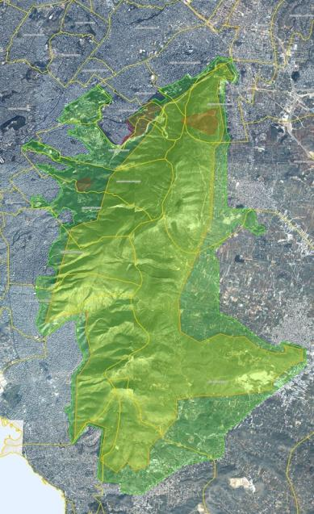




Forest Fire Crisis Management for the Prefecture of Messinia
AutoTrackTM FFIMS
Project Objectives
Decision Support Tool for the Local Government
Mission Planning / Scenario Execution / Training
Multi-agency Operational Resource Tracking
Precision Mapping of fuel data and crucial infrastructures such as road network, hydrants, water tanks, garbage collection points etc.
The collaborative forest fires crisis management that involves both Public Safety Agencies and Local government .
The common operation picture (COP) using state of the art geographic visualization systems in real time.
Provide the necessary software and hardware systems to S.N.O. (Prefecture Coordination Body) which is constituted according to the National Disaster Plan “Xenokratis”
Offer a systematic way of Crisis Management through the efficient usage of information and Resources
Εθνικό Μετσόβιο Πολυτεχνείο

Slide 7
Collaborative Incident / Crisis Management
AutoTrackTM FFIMS
Our approach…
Before the incident / crisis (Strategic Level)
  Constant risk estimation – assign prevention actions
  Maintenance of resources, personnel, key contacts
  Update of geographical data (critical infrastructures, operational points of interest)
  Mission planning, Standard operating procedures
  Training / Incident Scenarios
During the incidence / crisis (Tactical Level)
  Perform the actions to manage incidents / crisis
  Resource location and status tracking in digital maps.
  Automatic resource proposals according to pre-defined rules
  Execution of measures based on Standard Operating Procedures
  Collaboration between the involved parties - COP
  Access and study scenarios resembling the current situation

Slide 8
Collaborative Incident / Crisis Management
AutoTrackTM FFIMS
Our approach…
Post incident / crisis
  estimation of damages / losses
  maintain historical data and reports
  evaluation of actions (lessons learned)
  planning of forest restoration
  planning of restoration actions for the affected population
Σύνθεση
Γνώση
Διαδι-κασίες
Εργαλεία
Ρόλοι
Υποδομές
Αξιοποί-ηση
Τεχνικά μέσα

Slide 9
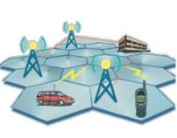

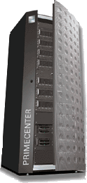
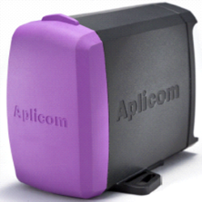


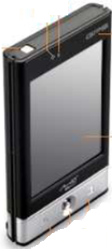
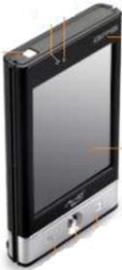
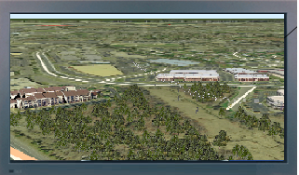



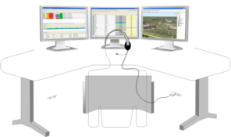
The deployed system at Messinia
Operation Resources
(Vehicles - Personnel – Equipment)
Prefecture of Messinia
Data Center
Central Monitors
Data
Internal Local Area Network
Network
Handheld Telematic Units GPS / GPRS
Installation of tracking devices GPS / GPRS
Collaboration
Messinia S.N.O. Users
Other Public Safety Agencies, Volunteers, Local Gov

Slide 10


AutoTrackTM FFIMS
The deployed system at Messinia
Mission Planning Algorithms
OptumSIM
Data Center
  Forest Fire Spread Simulation
  Optimum Spatial Distribution of Resources
  Emergency Routing
  Evacuation Risk
OptumRoute
Data
OptumLoc
OptumRisk
Web Services
S.A.F.E.R.
  Incident / Crisis Management
  Operational Resource Management
  Resource Tracking
  Resource Notifications & Dispatching
  Mission Planning
  End user collaboration tools
  3D streaming GIS engine

Slide 11
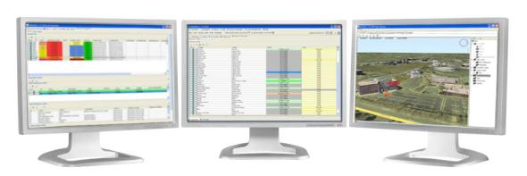
What is S.A.F.E.R.?
S.A.F.E.R.
…a modular software system for Collaborative Natural Hazards Crisis Management, Decision Support and Mission Planning
…provides all the tools for Multi-agency incident and resource management (RMS/CAD) by mapping the operations and hierarchical structure of each involved organization into the business workflow
… integrates various communications systems (PBXs, TETRA, VHF, Satcom) and mobile data terminals for call handling, notifications and resource alarming
…provides a GIS based Collaboration platform
…integrates efficiently various natural hazards simulation algorithms for mission planning and decision support.
Notes:
11

Slide 12
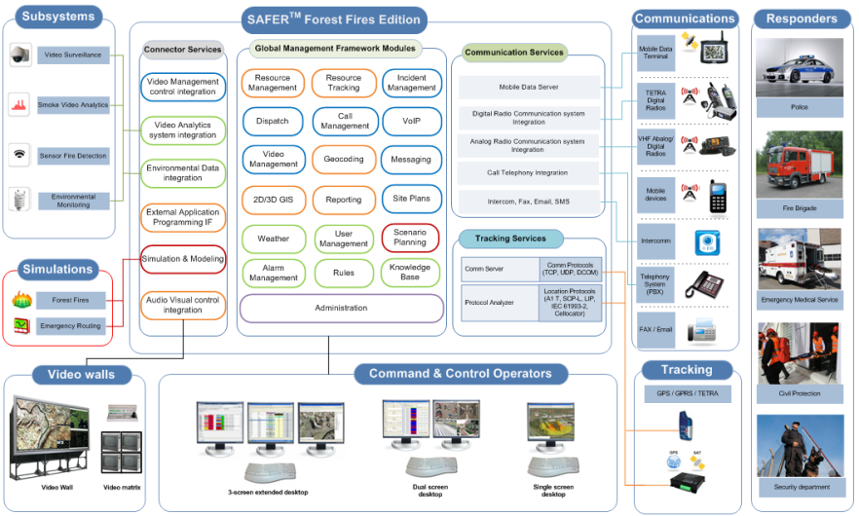
AutoTrackTM FFIMS
Logical Architecture
S.A.F.E.R. Modules

Slide 13

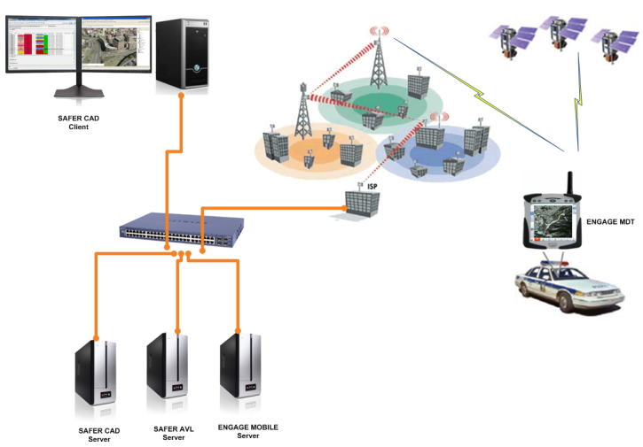
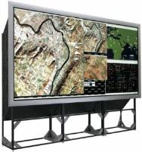



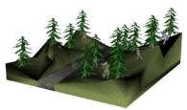

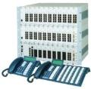



S.A.F.E.R.
S.A.F.E.R.
Video Operator
S.A.F.E.R.
DISPATCHER
Video Wall
S.A.F.E.R.
CALL TAKER
Mobile Data
UV sensors
Call Center
S.A.F.E.R. CAD
Server
S.A.F.E.R.
AVL Server
S.A.F.E.R. Mobile
Server
Sensor & Analytics
Server
Smoke Detection
Meteo Stations

Slide 14
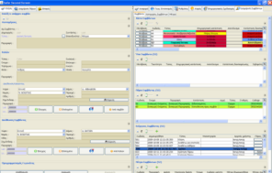
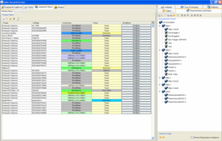
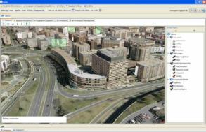
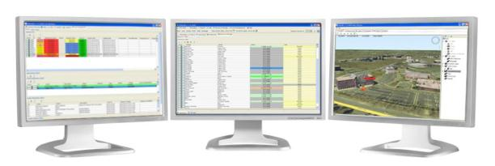
Graphical User Interface
S.A.F.E.R. - GUI (3 monitors case)
Call Data Capture
Incident Data
Resource management
Mission Planning tools
Resources, Actions, Measures
Scenarios Tools
3D GIS / Maps

Slide 15


S.A.F.E.R.
S.A.F.E.R.
Modes of Operation
Online Mode (Collaborative Incident / Crisis management)
Offline Mode (What-if scenarios & mission planning)

Slide 16
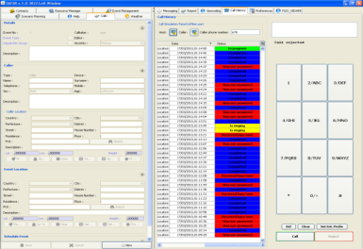
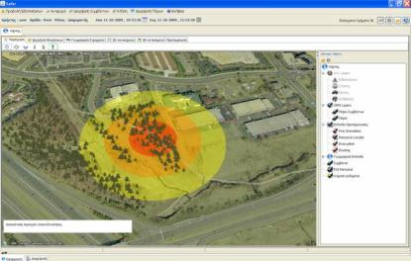
S.A.F.E.R.
Capture Incident / Crisis Data
S.A.F.E.R. - Call Taker Role
Call Data Capture
Capture Caller data and incident location
Incident type?
Assign Incident Type / Existing incidents correlation
Proximity?
Perform geospatial queries to locate nearby affected infrastructures
Actions?
Send information to individual dispatchers or groups

Slide 17
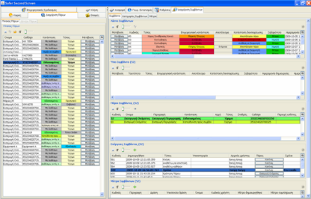
S.A.F.E.R.
Incident / Crisis Management
Dispatcher Role
Estimation of Risk
Situation analysis based on the Caller input and mapping data
Whom to dispatch?
Reserve, Assign Resources based on Location and Areas
Communicate
Alarm Resource, Monitor Resource Status / Use comm means
Collaborate
Exchange information / request resources / coordinate actions

Slide 18
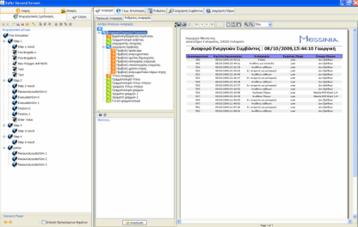
S.A.F.E.R.
Mission Planning and Scenario Management
What-if Scenarios
Create
Breakdown a scenario into a number of steps
Simulate
Forest Fire Simulation, Evacuation Planning etc.
Store
Store Scenario in Database
Replay
Retrieve and replay scenario in future

Slide 19
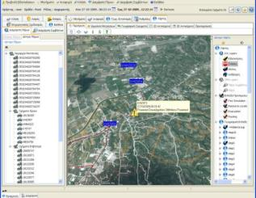
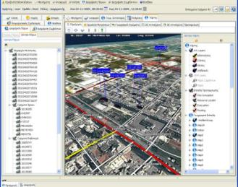
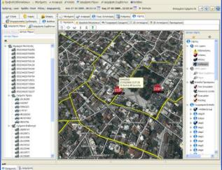
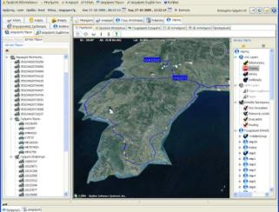
Resource Tracking
S.A.F.E.R.
Resource Tracking Subsystem
Last Position
Routes
Stops
Proximity
Address Geocoding
Over-the-air reconfiguration of telematic units
Support of GPRS/TETRA/VHF communication bearers

Slide 20
S.A.F.E.R.
SCENARIO Collaborative Resolution of a Forest Fire Incidence involving various Agencies and Local Government

Slide 21
S.A.F.E.R.
Αντιμετώπιση Συμβάντος
S.A.F.E.R.
Collaborative Incident / Crisis Management
Assign Incident ID
Enter incident data
Caller data
Automatic Depiction of relevant information on the map
Incoming 199/112 call
Forest Fire
Call answered
854
Location
Taigetos
900m from …
199 – Call-Taker

Slide 22
S.A.F.E.R.
Χρήστης Σ.Ν.Ο.
Fire Brigade Station
23
23
Incident data in the dispatcher screen
46
Notification of resources 23 and 46
854
Forest Fire
Location
Taigetos
Additional info
Fire Brigade Dispatcher

Slide 23
S.A.F.E.R.
When Additional Local Gov Resources are Required
Request Information
Request Information
854
854
S.P.E.K.
Civil Protection Department of Prefecture
S.N.O.
Forest Fire
854
Send incident data and resource requests
Fire brigade Dispatcher

Slide 24
S.A.F.E.R.
Request Information
Δασική πυρκαγιά
854
Στοιχεία
Resources
All the involved users:
  receive the necessary information
  manage their own only resources
  communicate with each other
  explorer mapping info
  notify personnel
  produce valuable reports
Municipality User
854
Δασική πυρκαγιά
Info
Πόροι
Civil protection department of Prefecture

Slide 25
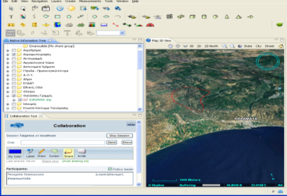
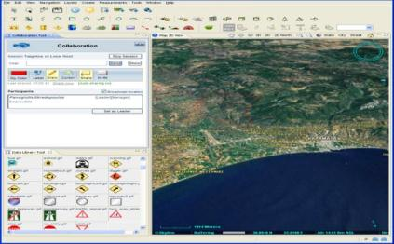
S.A.F.E.R. TM
S.A.F.E.R. - Advanced Collaboration Tools
Messaging
Real Time GIS Collaboration
    Map overlay drawings
    Chat
    Guided Fly-through sessions
VoIP calls

Slide 26
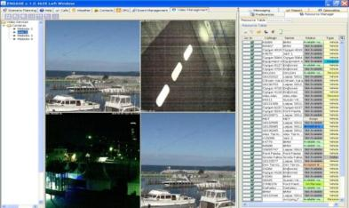
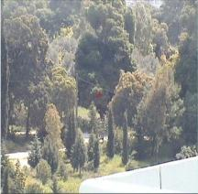
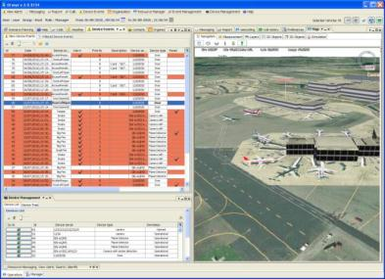
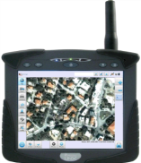
S.A.F.E.R. TM
S.A.F.E.R - Additional Capabilities
Video Management (CCTV)
Alarm Management
  Cameras with Smoke Detection Algorithms
  UV Sensors
Interconnection with Mobile Data terminals
Complex Event Processing (CEP) Engine

Slide 27
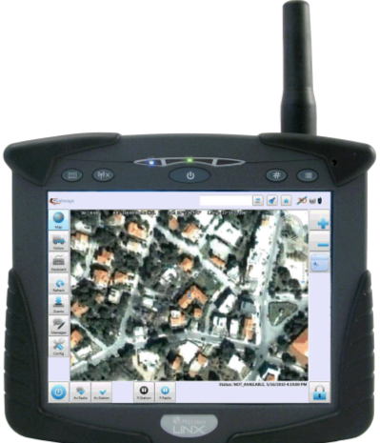
S.A.F.E.R. MDT TM
AutoTrackTM FFIMS
S.A.F.E.R. – Mobile Data Terminal
Software for Car/Tablet PC
Bi-directional communication with S.A.F.E.R.TM users back at the Center
  Incident Dispatch
  Messaging
  Status codes
Touch screen support
GIS Maps
Crew Login
Incident Routing
Address Geocoding
AVL GPS Functionality
TETRA PD/SDS, GSM/GPRS, VHF
Supervisor Audit Control

Slide 28
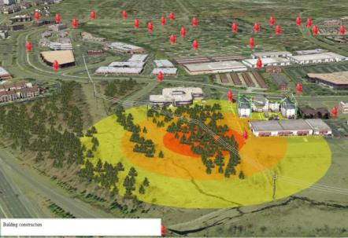
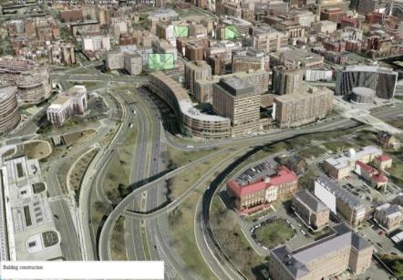
S.A.F.E.R. - 3D GIS
3D Photorealistic visualization
Various tools (terrain profile, Best path etc.)
Advanced Streaming technology
Real-time map navigation
Unlimited volume of data (TeraBytes)
Support of OGC WMS, WFS
Unparallel performance

Slide 29
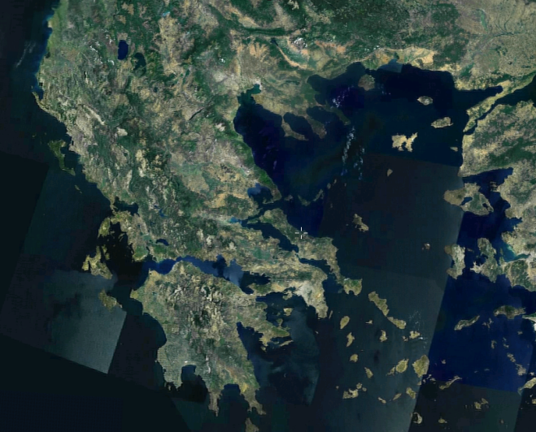
Geographic data
Data Center
Raster Data
Elevation Data
Vector Data
Live Data
Satellite photos of average resolution for the entire Greece
(Landsat 7, 15m)

Slide 30
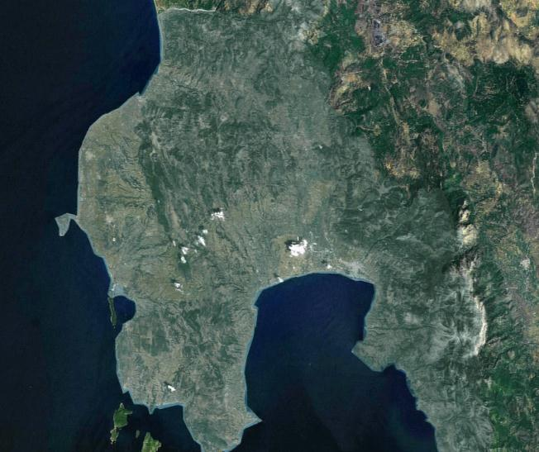
Geographic data
Data Center
Raster Data
Elevation Data
Vector Data
Live Data
Satellite imagery for Messinia Prefecture (Spot 2.5m)

Slide 31
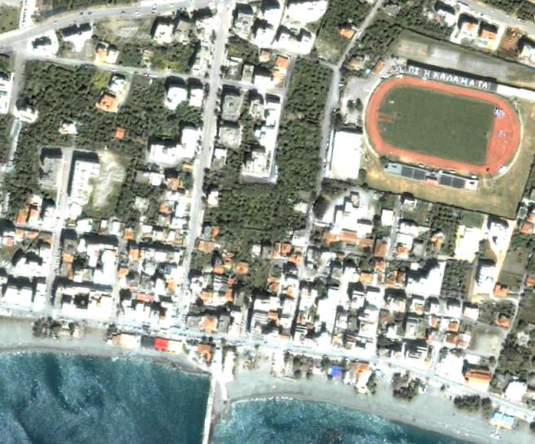
Geographic data
Data Center
Raster Data
Elevation Data
Vector Data
Live Data
High resolution Satellite photos (QuickBird 60cm)

Slide 32
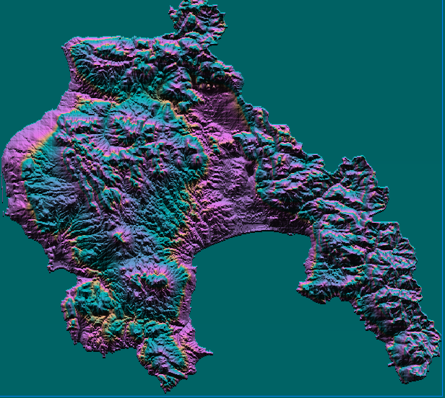
Geographic data
Data Center
Raster Data
Elevation Data
Vector Data
Live Data
Production of a high resolution DEM

Slide 33
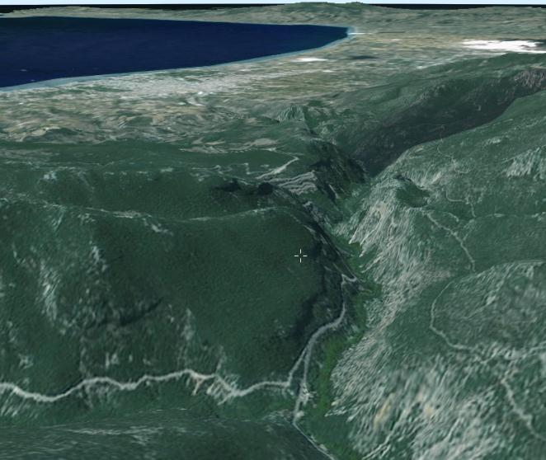
Geographic data
Data Center
Raster Data
Elevation Data
Vector Data
Live Data
Combination to produce the 3D Terrain

Slide 34
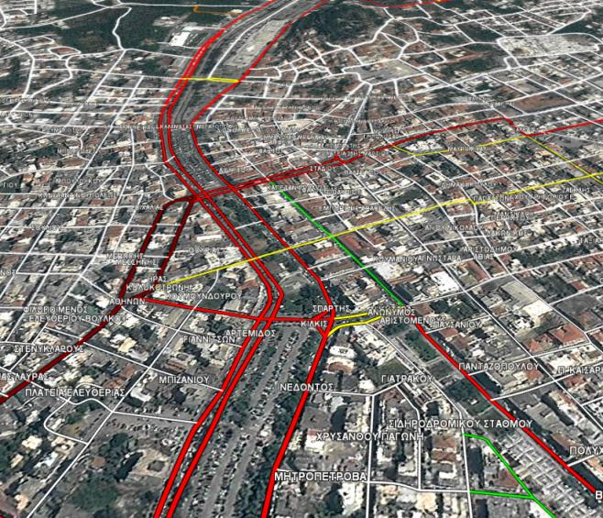
Geographic data
Data Center
Raster Data
Elevation Data
Vector Data
Live Data
Road Network (Main, Secondary, Urban, Forest)

Slide 35
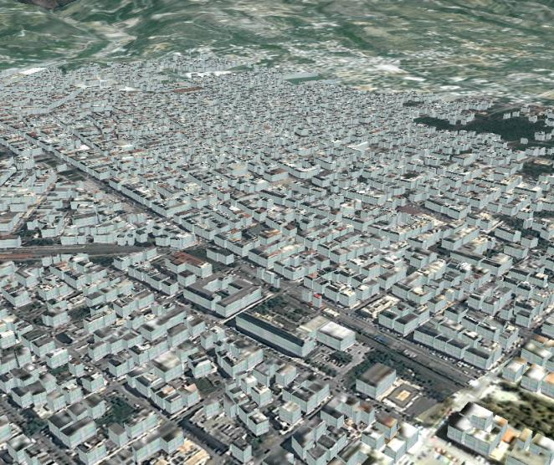
Geographic data
Data Center
Raster Data
Elevation Data
Vector Data
Live Data
Building and Blocks

Slide 36
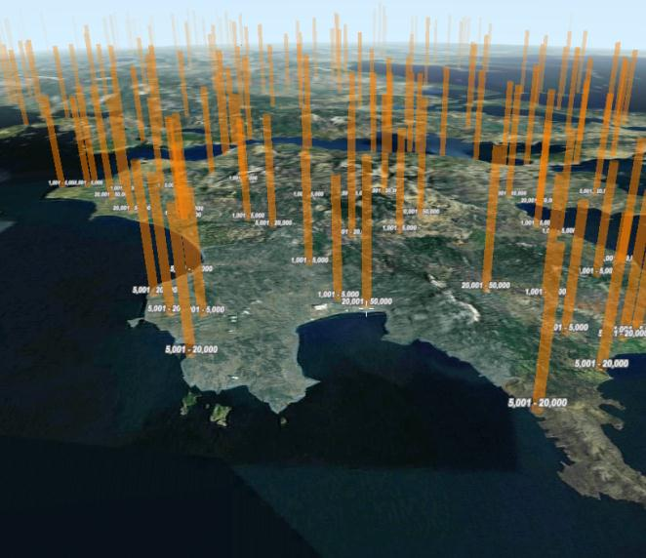
Geographic data
Data Center
Raster Data
Elevation Data
Vector Data
Live Data
Population data from the National Statistics Service

Slide 37
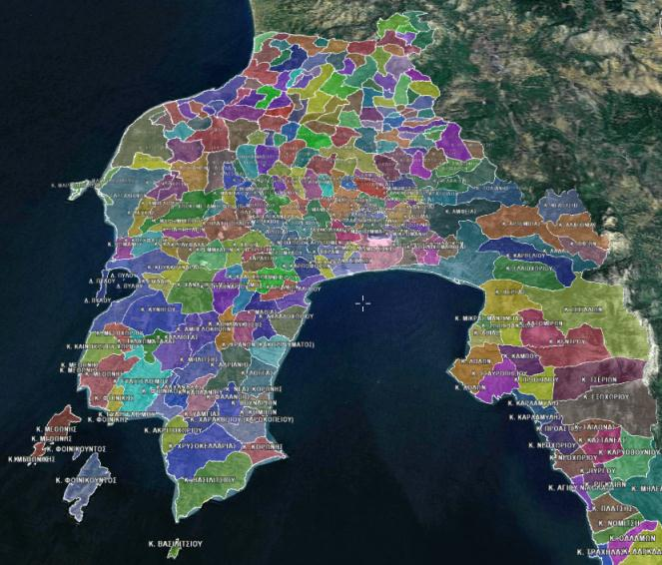
Geographic data
Data Center
Raster Data
Elevation Data
Vector Data
Live Data
Administrative areas

Slide 38
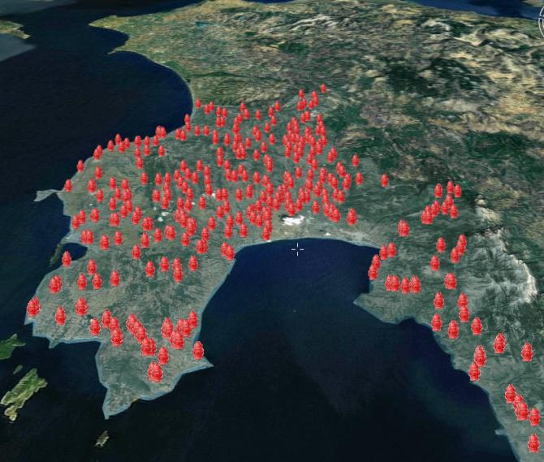
Geographic data
Γεωγραφικά Δεδομένα
Data Center
Raster Data
Elevation Data
Vector Data
Live Data
Hydrant locations and their status

Slide 39
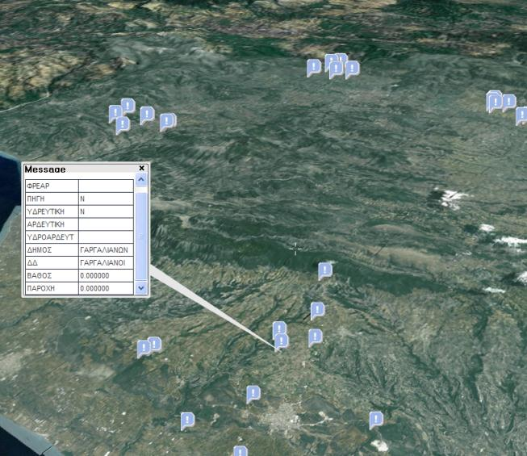
Geographic data
Γεωγραφικά Δεδομένα
Data Center
Raster Data
Elevation Data
Vector Data
Live Data
Water supply points – Tanks

Slide 40

Geographic data
Data Center
Raster Data
Elevation Data
Vector Data
Live Data
Fuel data

Slide 41

Geographic data
Data Center
Raster Data
Elevation Data
Vector Data
Live Data
Fire Brigade Services and Stations

Slide 42

Geographic data
Data Center
Raster Data
Elevation Data
Vector Data
Live Data
Forest Restoration Areas

Slide 43

Geographic data
Data Center
Raster Data
Elevation Data
Vector Data
Live Data
Garbage Collection Areas

Slide 44

Geographic data
Data Center
Raster Data
Elevation Data
Vector Data
Live Data
Places / Villages

Slide 45

Geographic data
Data Center
Raster Data
Elevation Data
Vector Data
Live Data
Various Points of Interest

Slide 46

Geographic data
Data Center
Raster Data
Elevation Data
Vector Data
Live Data
Meteorological data from stations

Slide 47












Geographic data
In total lots of TeraBytes of information needs to be gathered
Maintenance/Updates is mandatory

Slide 48


Mission Planning
AutoTrackTM FFIMS
S.A.F.E.R. TM
Mission Planning Tools
  Forest Fire Spread Simulation
  Optimal Spatial Distribution of Resources
  Emergency Routing
  Evacuation Risk

Slide 49

Mission Planning
S.A.F.E.R. TM
Forest Fire Simulation ⁽¹⁾
SOAP Web Service
OptiFireTM
  Using:
  real time meteo data or hypothetical data
  Fuel data
  Digital elevation model
Answers the following:
  After how much time the fire front
  will reach point Χ?
  What will be the fire front in Y hours?
  Which fire front is more dangerous?
Request
Response
OptiFireTM Simulation System
Concurrent multi user execution
Based on BEHAVE model

Slide 50

Mission Planning
S.A.F.E.R. TM
Forest Fire Simulation ⁽²⁾

Slide 51

Emergency Routing
S.A.F.E.R. TM
Emergency Routing
SOAP Web Service
OptumRoute
  How do we arrive at a fire front without using roads that are going to be blocked?
  How do we route vehicles in multiple fire fronts from multiple stations?
  In which way a new road will affect operations;
  How to route resources in case of an X incident;
Request
Response

Slide 52

Χωροθέτηση Οχημάτων Υποστήριξης
S.A.F.E.R. TM
Optimum Spatial Distribution of Resources
  Applicable for:
  fire brigades
  water trucks
  ambulances
Using the road network data we can calculate:
  How many vehicles do we need in order to cover a given area in 10 maximum minutes?
  Which are the best locations of these vehicles?
  How will a new road affect the response;
SOAP Web Service
OptumLoc
Request
Response

Slide 53

Evacuation Risk
S.A.F.E.R. TM
Evacuation Risk under Panic Conditions
with the use of:
  Road network data
  Buildings and Population
  we can estimate:
  Which streets will be congested in case of evacuation
  How will a new road will affect the evacuation risk
  If we can reserve an X street only for use by operational resources
SOAP Web Service
OptumRisk
Request
Response

Slide 54
AutoTrackTM FFIMS
S.A.F.E.R - System Advantages
Enterprise C3i multi-user application that supports:
  Multiple Organizations / Agencies
  Multiple Users and Roles
  Common Operational Picture
  Mutual production of scenarios and operational plans
  Integration of all software subsystems into a single end user application
Open architecture (alarms from smoke and flame detection systems)
Advanced 3D mapping engine with unparallel performance and capabilities
Interoperability with other platforms via a well documented SDK and usage of industry standards
Integration of Web Service based mission planning tools like forest fire spread simulation, optimum spatial distribution of resources, emergency routing and evacuation risk.

Slide 55
Integrated Information System for
Mission Planning
and Forest Fires Crisis Management
Q/A

Slide 56








Headquarters - Engineering
3 Chr. Lada Str., Athens, Greece
Tel: +30-210-6840036
Fax: +30-210-6840037
Web: www.satways.net
Email: info@satways.net

